Slide 1
Building LOA5 Animated Humanoids using HAnim and X3D
Creating the Bones examples in HAnim Archive
Don Brutzman and Joe D. Williams
Humanoid Animation (HAnim) Working Group
Web3D Consortium
draft 27 May 2026

Slide 2
Humanoid Animation (HAnim) Overview
background
HAnim is an abstract representation for modeling 3D articulated figures, including but not limited to human beings.
The HAnim specification is an International Standard that describes a standard way of representing humanoids. When followed, HAnim allows human figures created with modelling tools from one developer to be animated using tools from another developer.
HAnim is directly implemented in the X3D Architecture with examples that are widely available and deployable.
HAnim Architecture draft v4.1 is tracking current developments

Slide 3
X3D Overview
background
Extensible 3D (X3D) is a software standard for defining interactive web- and broadcast-based 3D content integrated with multimedia.
X3D is intended for use on a variety of hardware devices and in a broad range of application areas such as engineering and scientific visualization, multimedia presentations, entertainment and educational titles, web pages, and shared virtual worlds.
X3D is also intended to be a universal interchange format for integrated 3D graphics and multimedia.
X3D Architecture draft v4.1 is tracking current developments

Slide 4
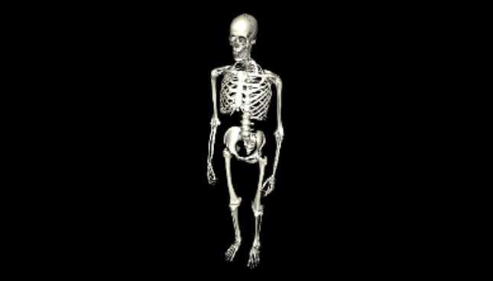
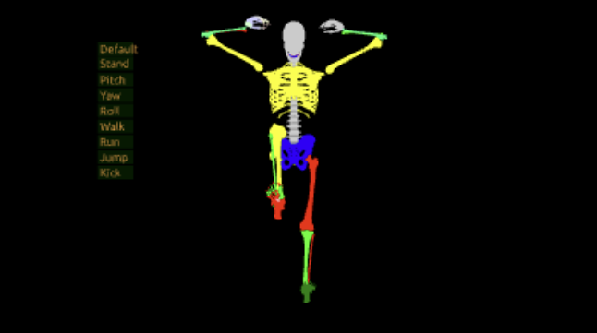
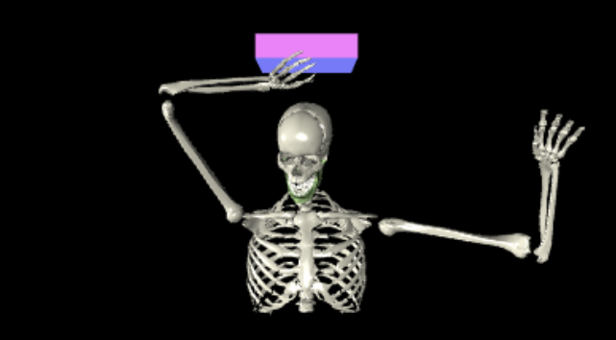
Many available models used for this development
background
These are predecessor modes used during this work, listed in approximate order of development:
SkeletonCompleteNoNormals
AnimatedAssembledHumanSkeleton
Running skeleton (not yet submitted to archive)
LaughingUpperSkeleton

Slide 5
Draft changes, HAnim v2.1, X3D v4.1 Architectures
X3D 4.1
HAnim v2.1
New capabilities for HAnim draft v2.1 specification
LOA-5 nodes for bones, cartilage that are not ordinarily animatable
Full anatomical fidelity, working towards potential medical usage
Design and implementation coveroids for clothing and fashion
New capabilities for X3D draft v4.1 specification
InlineGeometry node for select retrieval of STL, PLY, other meshes
Simplification and testing of EXPORT, IMPORT capabilities
Potentially further improvements to simplify large skeleton animations

Slide 6
HAnim nodes represent joints and segments
background
Humanoid object is a container for all components that define the skeleton, geometry and landmarks of the HAnim figure.
  Typically includes model metadata
Joint object is the fundamental building block that models the relative transformations for each articulated body part.
  Strict naming requirements for uniqueness and interoperability
Segment object is a container for information (such as geometry) about a single segment of the body.
  Strict naming requirements for uniqueness and interoperability

Slide 7
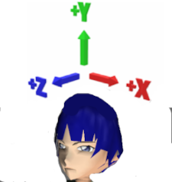
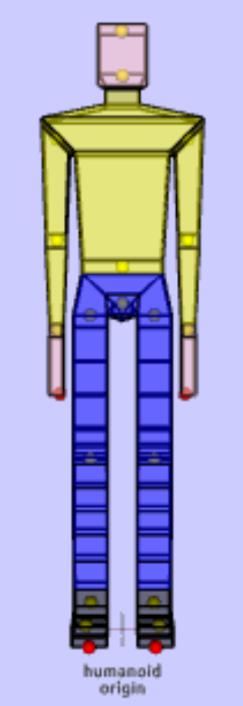
HAnim Coordinate System
background
HAnim humanoid models are defined using a right-handed coordinate system. Rotations follow the right-hand rule.
Given an origin centered between feet on the ground plane and the relative perspective of the humanoid model:
+X axis direction is defined as left side of the humanoid, while the -X axis direction is defined as the right side of the humanoid.
+Y axis direction is defined upward towards the top of model, while -Y axis direction is downwards towards bottom of the feet.
+Z axis is defined as the anterior direction towards the front of the model, while the -Z axis is defined as the posterior direction towards the back of the model.
Default size units are meters
other size units can also work but other complications arise

Slide 8
Naming conventions for node DEF and name field
background
Strict name enumerations are uniquely defined for most joints and segments in the human body, strictly matching HAnim vocabulary
Alternative names can also be used (but aliases are not interoperable)
DEF labels are also unique node identifiers, having a consistent prefix (for example, hanim_ or Henry_) that match the prefix given in the topmost DEF of the parent HAnimHumanoid.
This approach allows consistent run-time interoperability within a Humanoid model, while also allowing multiple independent X3D models to coexist when multiple different X3D models are composed together.
Careful naming following these convention lets multiple models and animations work together interoperably, without mutual interference.

Slide 9
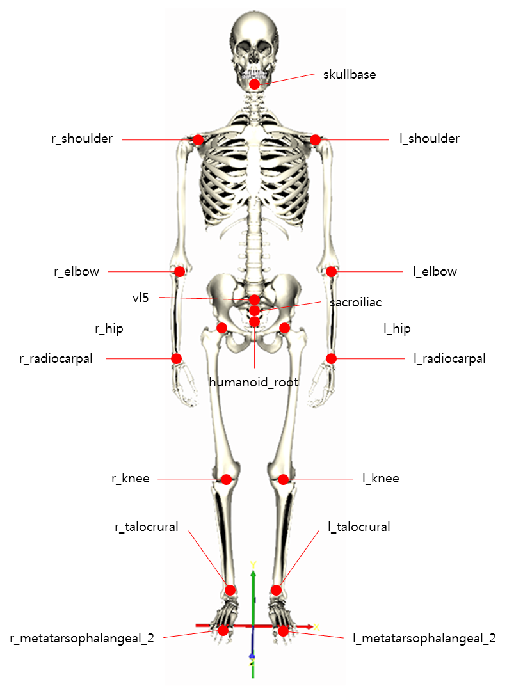
HAnim Levels of Articulation (LOA) 0 to 5
X3D 4.1
HAnim v2.1
Animation interoperability is a key design goal of LOA representations, where animations for less-detailed LOAs can work correctly for humanoids at more-detailed LOAs. This enables composability of both model geometry and animation sequences.
The purpose of each LOA follows:
LOA-0. Humanoid location and direction,
LOA-1. Simple animation and poses,
LOA-2. Accepted baseline motion and sports,
LOA-3. Clothing and apparel plus individual's body posture,
LOA-4. Anatomically correct human skeleton with all movable joints.
LOA-5. Adds bone segments, cartilage connections, and teeth that are not
ordinarily animated.
New in v2.1

Slide 10
Implementation Tools and Assets
X3D 4.1
HAnim v2.1
X3D-Edit Authoring Tool
Sunrize Editor with X_ITE Browser and X_ITE Playground Editor
X3DOM Browser and X3DOM Editor
X3D Documentation stylesheet producing HTML pages
X3D Quality Assurance (QA) tests
X3D Example Archives for Humanoid Animation models
Additional utility programs

Slide 11
Inline, EXPORT and IMPORT
X3D 4.1
Inline node is essential for model re-use, composition and scalability
  Loads a model and embeds it in the current scene graph
  Support for X3D XML, ClassicVRML, JSON, and binary encodings
  Support for glTF 2.0 either in JSON or binary encoding
EXPORT statement
  Allows an author to specify nodes in the model that can be directly accessed at run time for animation purposes (e.g. HAnimHumanoid)
IMPORT statement
  Allows next author to gain access to those EXPORTed nodes of Inline model
Mantis Issue 1530 shows simplified mechanisms for humanoids to avoid duplicative statements beyond top-level HAnimHumanoid

Slide 12
InlineGeometry retrieves mesh geometry
X3D 4.1
InlineGeometry is a newly proposed and implemented node
  Retrieves geometry only, typically providing a mesh of polygons
  Initially designed to support STL and PLY formats for 3D printing,
  Also usable with X3D, VRML, and possibly other file formats
Benefits
  Allows application of independent Appearance and Material nodes (e.g. blue)
  Avoids retrieving any other unrelated (or unwanted) X3D nodes in the remote model that Inline IMPORT might return, avoiding clutter and confusion
InlineGeometry allows authors to create a custom HAnimHumanoid that only re-uses HAnimSegment geometry of interest
  EXPORT and IMPORT statements no longer pertain

Slide 13
Resizing an HAnim skeleton
Original JinLOA4.x3d and JinLOA4Animated.x3d
… which served as HAnim hierarchy template for Bones model
After inserting individual bones, necessary to adjust joint center of rotations so that skeleton with bone segments of different lengths can re-use the same animations
Expectation worth future testing: since HAnim animations are primarily about rotations, with position handled at humanoid_root HAnimJoint node, we expect that different sets of animations will work equivalently for different humanoids each having different size scales
  TODO show this. Maybe we have one already??

Slide 14
Original availability of HAnim Bone models
Realization we had a complete legacy set of bones – so, why not use it?
Damon’s original models: each bone in inches, in place (circa Web3D 2004)
Several generations of models in X3D Example archives, several rounds of incremental modification, we gradually figured out best authoring patterns
Since original bones models originally in inches, John rescaled values to meters
John then recentered Coordinate points to local origin, then added parent Transform to restore position of each bone relative to Humanoid center at 0 0 0
  Scale.py and CenterCoordinatePoints.py source, these were essential contributions
Add TouchSensor visualization: hover descriptions, blue lighting, viewpoint
The AllBonesCollection.x3d model shows that all bones are positioned OK
Note that all current and derived work is open source with no restrictions

Slide 15
Production workflow to create HAnim skeleton AllBonesLOA5Skeletons.x3d
Copy an empty humanoid hierarchy (using JinLOA4 as template)
Ensure all geometry in meters, aligned with HAnim coordinate system
Apply name fields matching DEF prefixes within new HAnimHumanoid
Retrieve, insert correct geometry within each Joint, Segment tree
  Use Inline for prepositioned models (left-side white skeleton)
  Use InlineGeometry for zero-centered meshes, then Appearance/Material throughout (right-side blue skeleton)
Adjust HAnimJoint center fields to match centers of rotation
  So far, LOA-0 and LOA-1 joint center adjustments are complete, more to follow
Test visually at each step for correct placement, with animations showing that joint rotations work correctly for each
X3D-Edit and visualization essential throughout
  Careful examination, frequent XML validation, Quality Assurance (QA) testing
Notes:
Diagram?

Slide 16
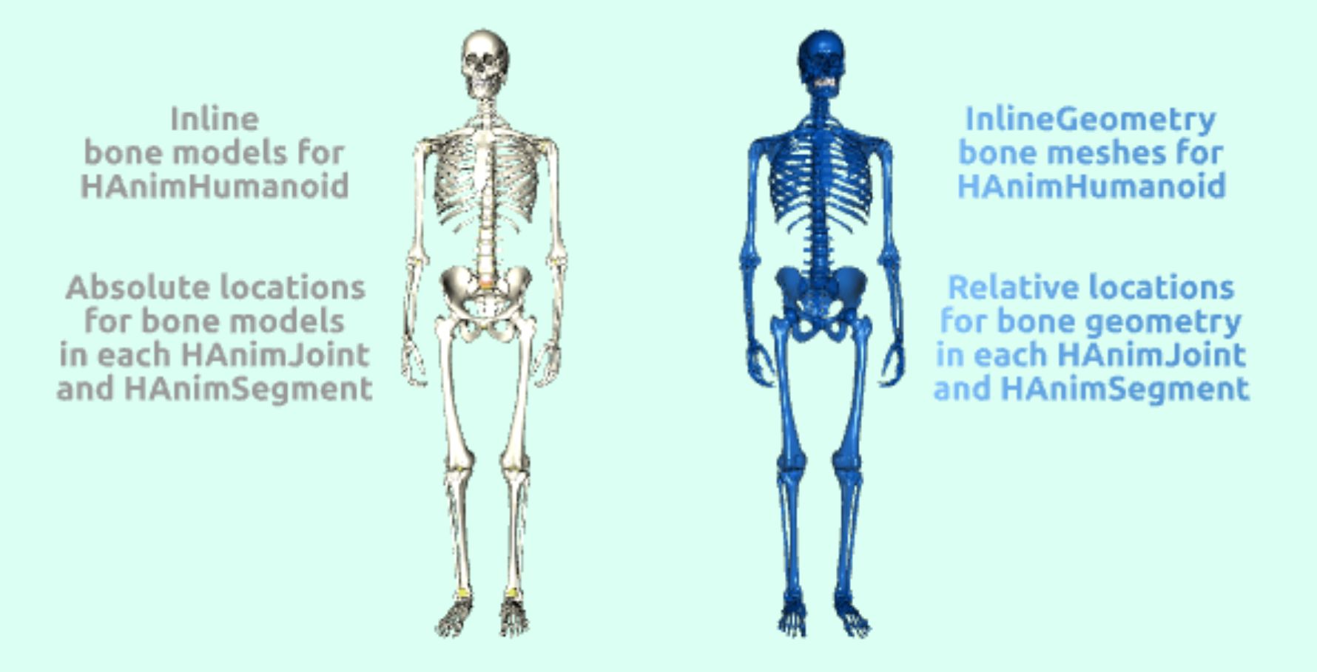
Example HAnim/X3D for absolute Inline models and relative InlineGeometry meshes
X3D Example Archives: Humanoid Animation, Bones,
All Bones LOA 5 Skeletons
Online example: AllBonesLOA5Skeletons
Both of these models apply exact same HAnimHumanoid, HAnimJoint, HAnimSegment structures

Slide 17
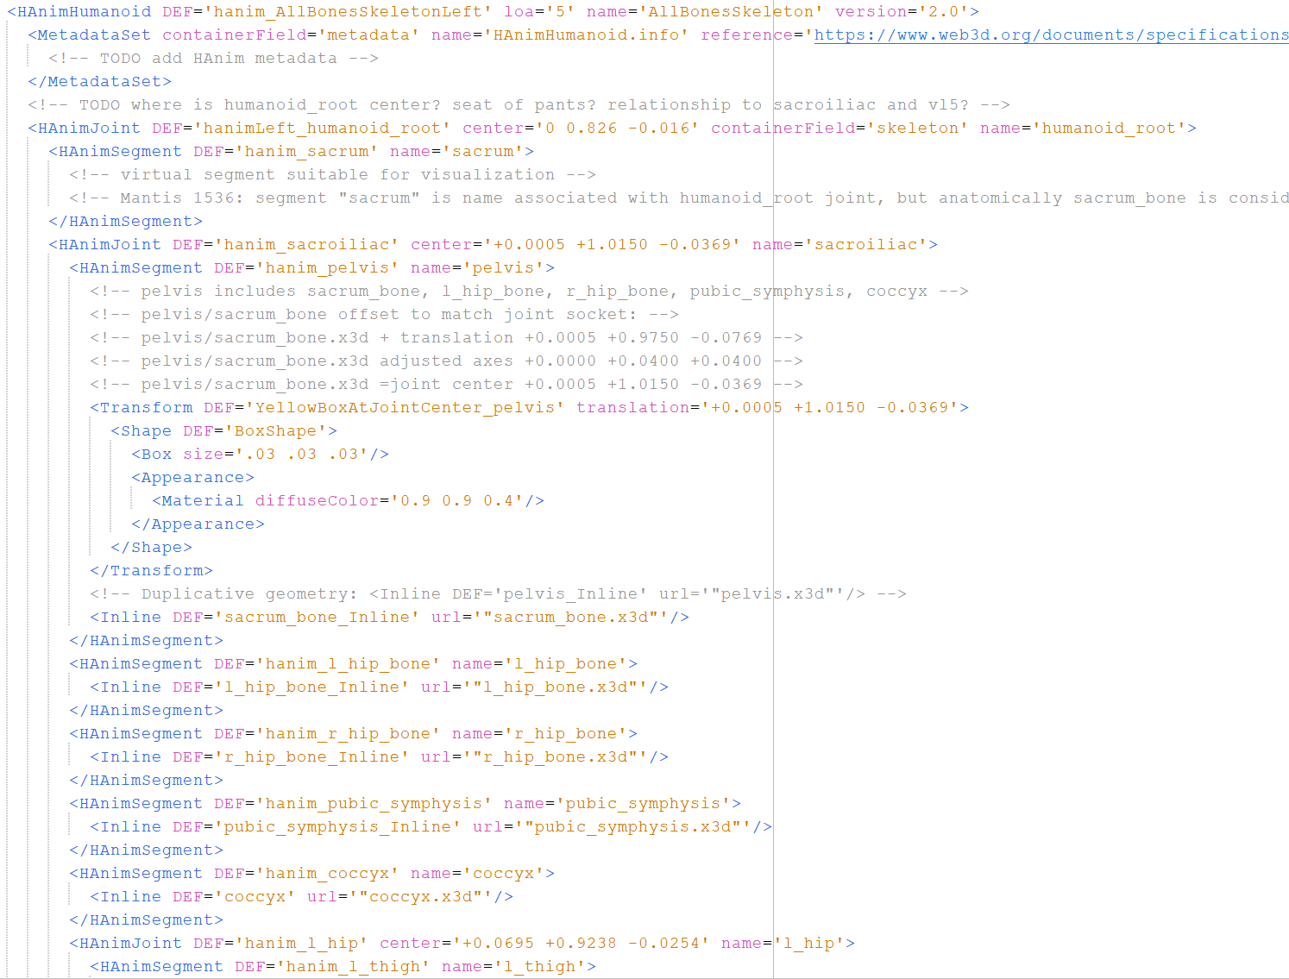
Design pattern
Scene graph: HAnimJoint,
HAnimSegment repeats for fully named skeleton hierarchy
HAnimJoint center of rotation adjustments must be added for each Inline model
(or InlineGeometry mesh)
Scene graph
Compute HAnimJoint
centers of rotation
HAnimJoint (transform)
HAnimSegment (shape)
HAnimSegment (shape)
HAnimSegment (shape)
HAnimSegment (shape)
HAnimSegment (shape)
  HAnimJoint (transform)
    HAnimSegment (shape)
    HAnimJoint (transform)
      etc. etc. etc.
Notes:
Overlay boxes to match diagram?

Slide 18
Show how comment blocks computed
Show construction of test interpolators
Copy + paste, then arithmetic performed to compute joint center for each bone:
<!-- l_tibia.x3d is knee bone used to adjust and match joint socket: -->
<!-- l_tibia.x3d + translation +0.0858 +0.2663 -0.0542 -->
<!-- l_tibia.x3d adjusted axes +0.0000 +0.1970 +0.0200 -->
<!-- l_tibia.x3d =joint center +0.0858 +0.4633 -0.0342 -->
Next: Java program that computes these values for existing scenes, generating appropriate comments for remaining unadjusted scenes used in LOA2, 3 and 4 animations. Now working, with fine tuning.
As axis of rotation is determined for each bone, the program integrates those axisOffset values with the parent Joint
This is difficult and tedious… thus a great candidate for tool support!

Slide 19
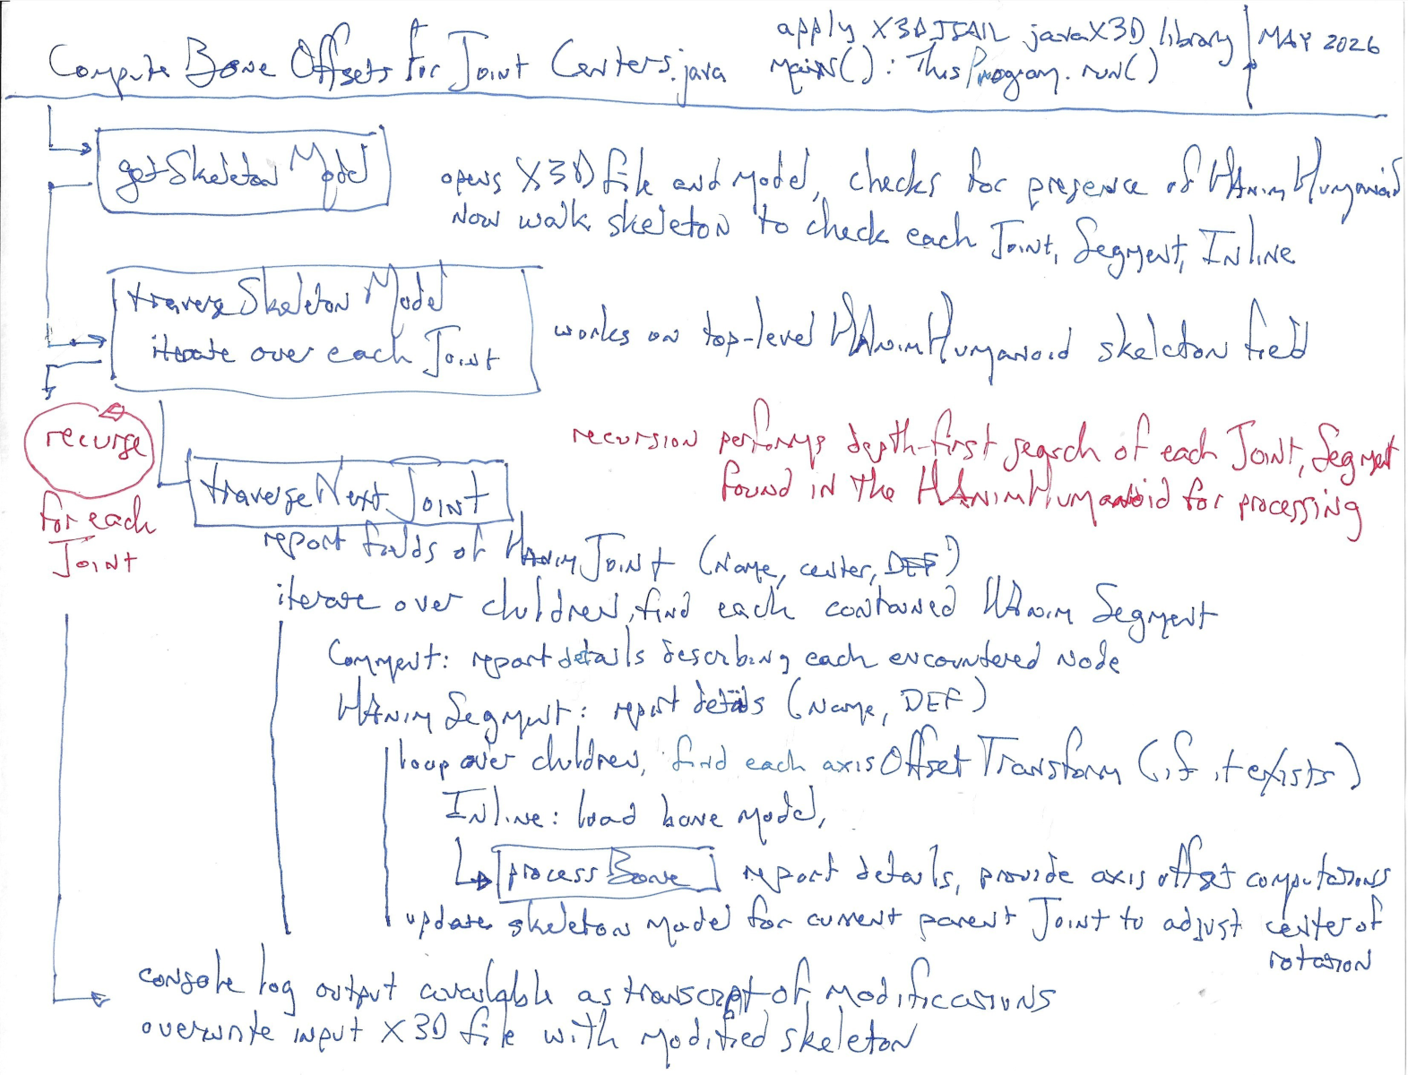
ComputeBoneOffsetsForJointCenters.java
Inputs
HAnimHumanoid X3D model with comprehensive skeleton
Multiple X3D models archived in Bones directory
Processing
Correlate values, Inline to Joint
Outputs
Updated Joint centers applied to input skeleton model
Console log of changes
Program source code
uses model loading, validation, data structures provided by X3DJSAIL X3D Java SAI Library
Javadoc documentation
Program Flowchart (this figure)

Slide 20
Status of ongoing progress in this effort
X3D 4.1
HAnim v2.1
Correctness confirmed for LOA-1, namely 2 dozen bones out of many
  HAnimJoint nodes #150 total
  hierarchy levels 28 deep
  HAnimSegment nodes #251 total
Next, will visually inspect and modify all LOA-2, LOA-3, LOA-5 bones to compute each axisOffsetTransform adjustment to parent HAnimJoint
  TODO: try to show each successive LOA with axes displayed, once possible
Result: fully capable human LOA-5 model with all joints and bones
A fully detailed
LOA-5 skeleton
is big!

Slide 21
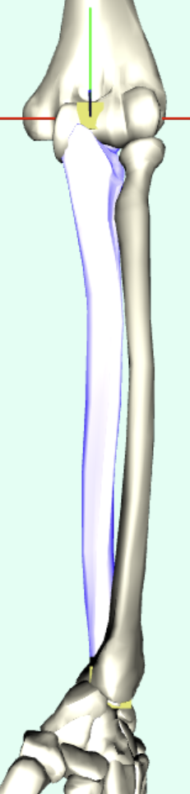
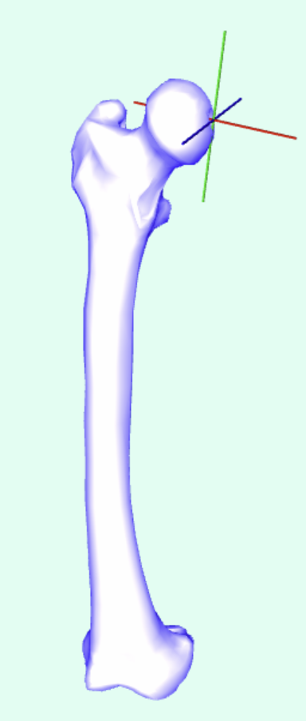
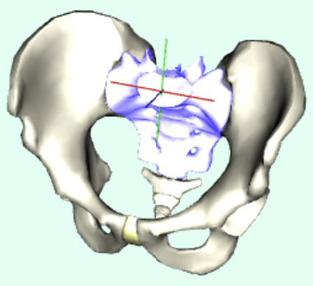
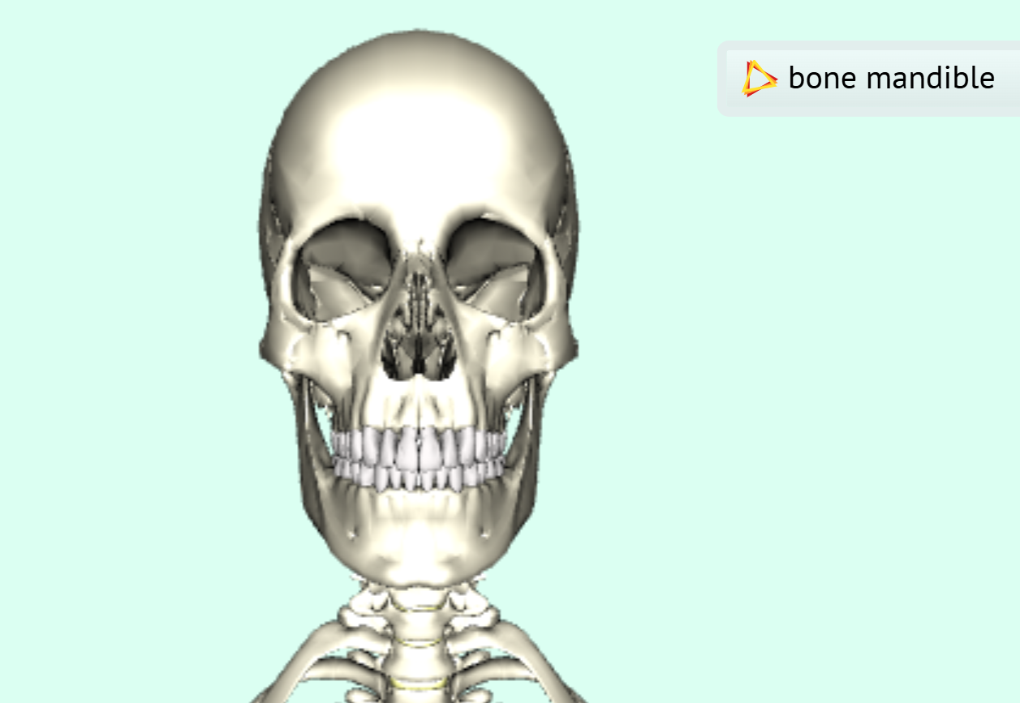
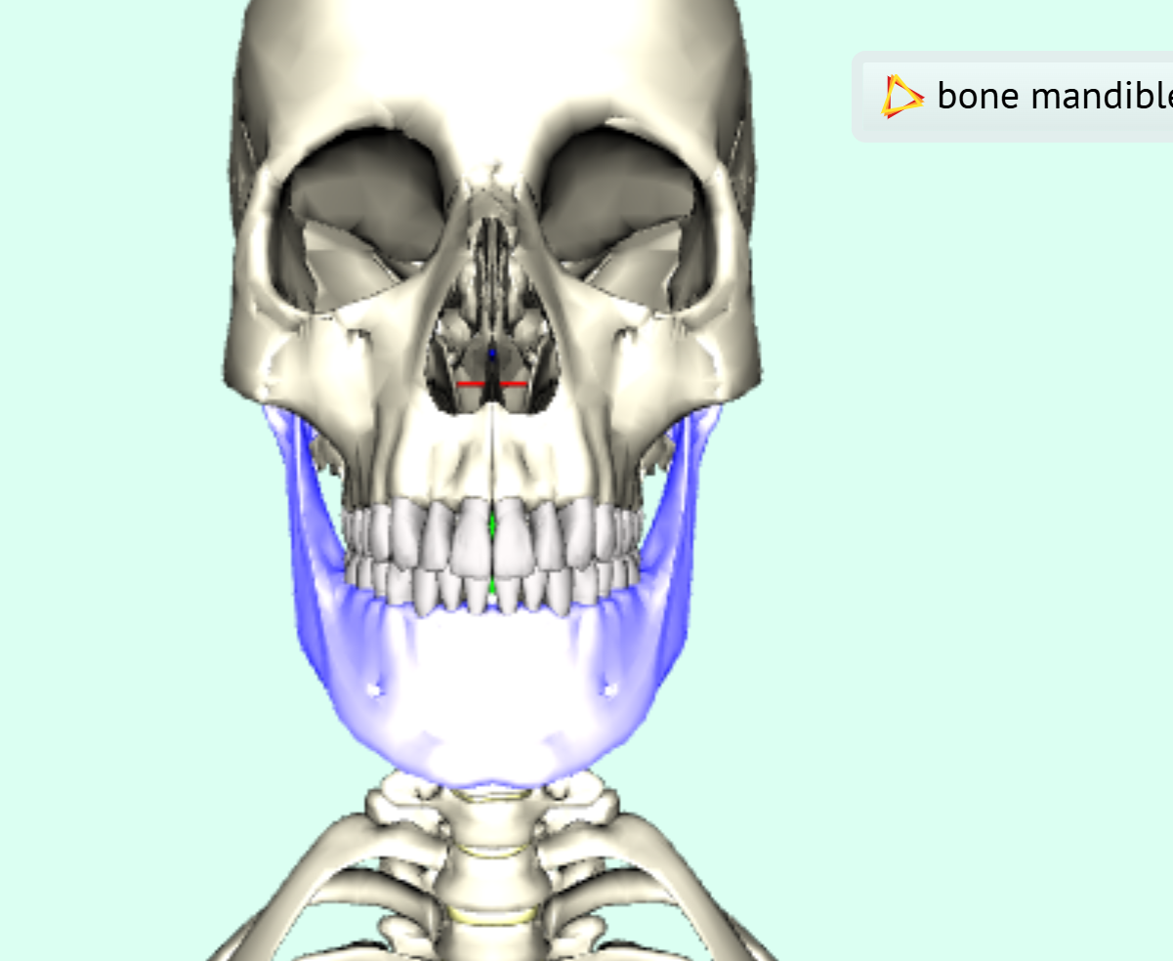
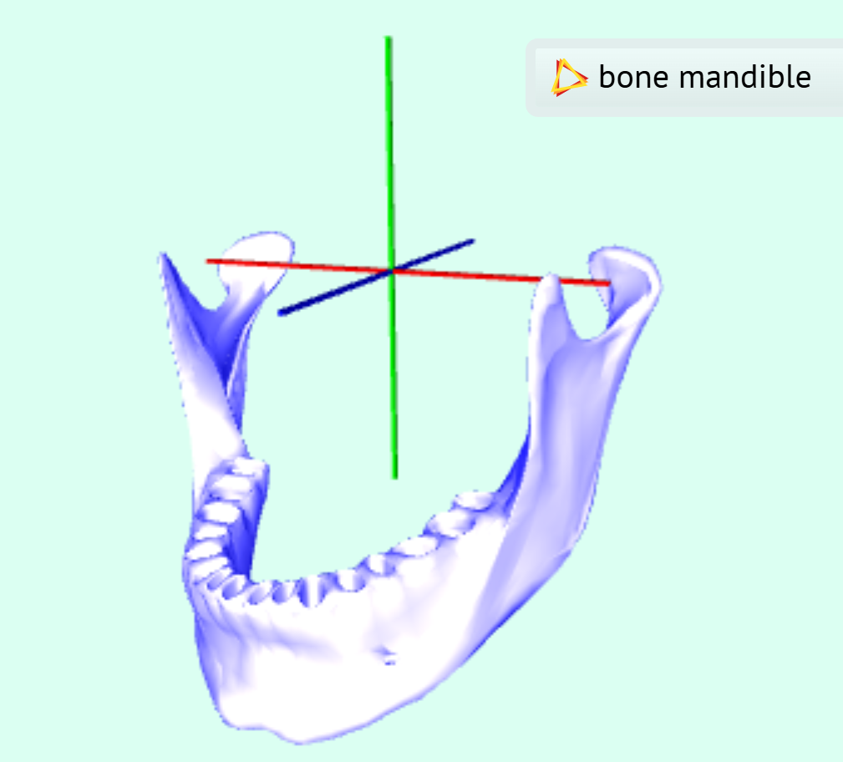
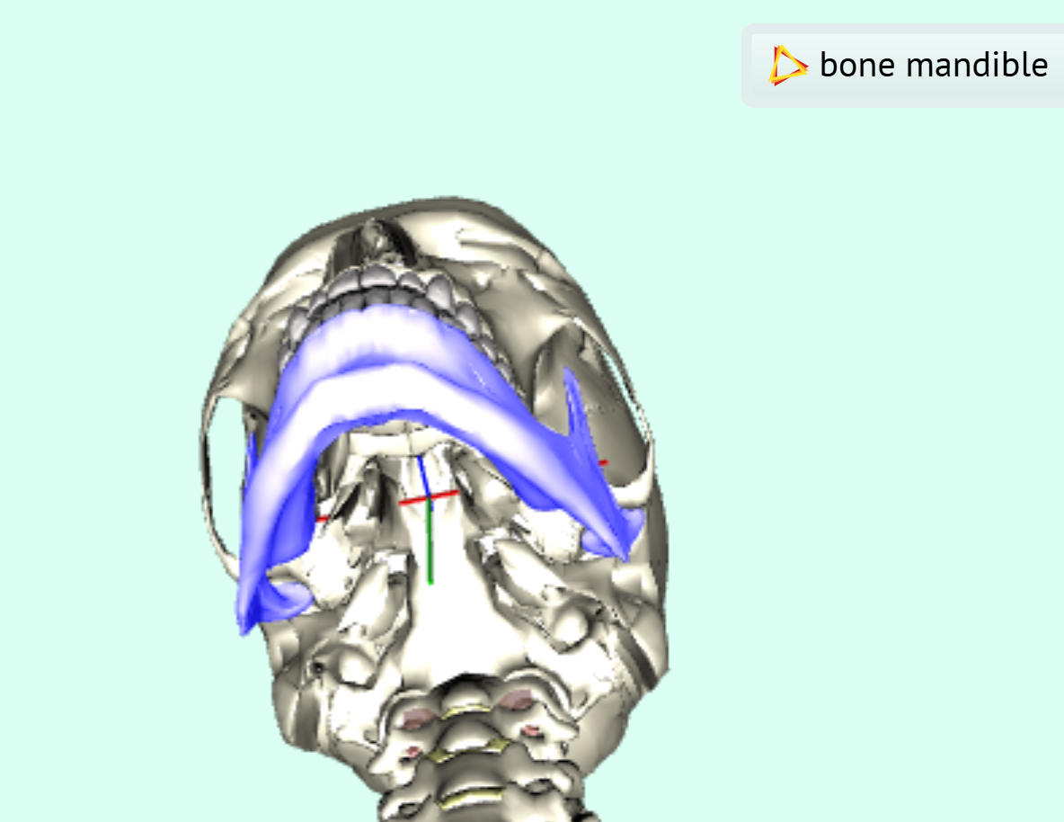
Visualizing Joint centers of rotation is necessary!
Difficult to coordinate both relative location and rotation center for joints
  If Joint center of rotation is incorrect, bone animation is wildly disconnected
Not feasible to keep track of hundreds of named joints and segments
  Precise pairwise HAnim X3D naming conventions for DEF, name fields is essential
  Many approaches considered, simplicity remains best, confirms specifications OK
Each individual bone model has TouchSensor as a user trigger for
  Hover: displaying name of segment geometry to aid visual inspection, exploration
  Select: toggle highlight lighting, bind close-in viewpoint, display X-Y-Z axis if present
  No custom scripts, all native X3D. Essential for visual debugging and usage of models.

Slide 22
Where is joint center of rotation, exactly?
Human body joints are tightly coupled and connected together
“Medical” joint center is likely not in exact geometric center, though
Note that center of rotation is not static when human body moves
In contrast, 3D graphical simulation carefully approximates the body
The center of rotation needs to be close enough so that the relative motion between parent joint and child geometry rotates smoothly
This might not exactly match what medical community considers each center value to be, but smooth animation is essential to avoid user distraction and display artifacts (such as disconnecting bones)
  Thus not ready for medical use, but good for visualization and exploration

Slide 23
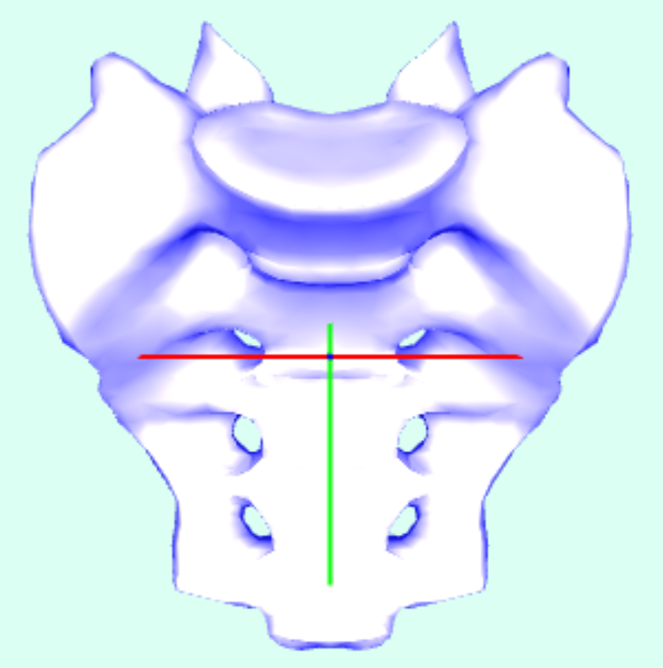
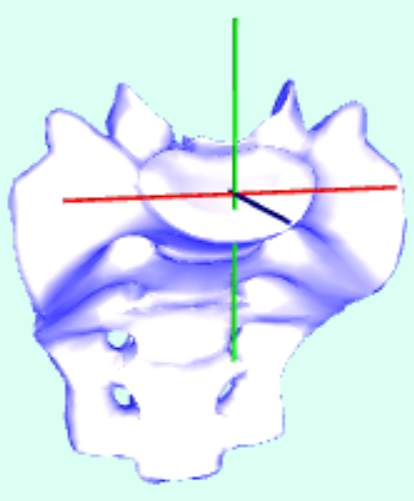
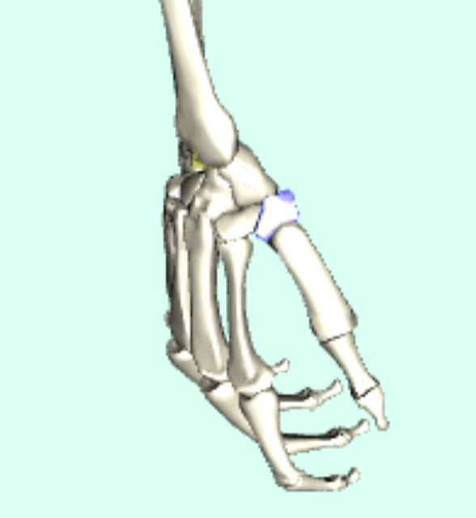
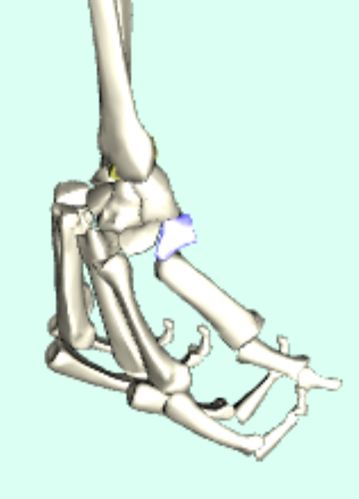
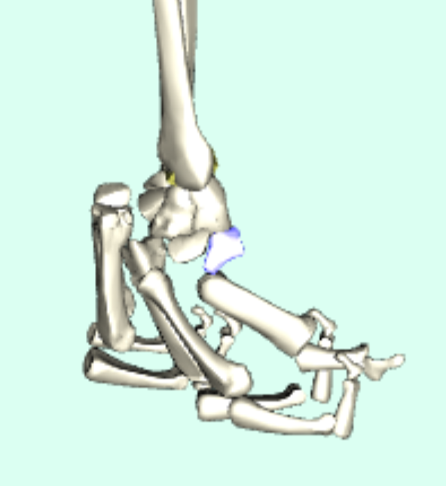
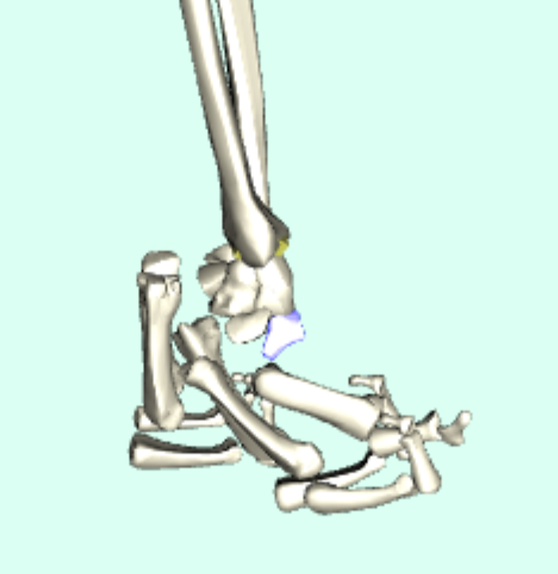
Recognizing erroneous joint centers of rotation
Adjusting original center for sacrum_bone model:
Missing joint centers of rotations for fingers (ouch)
Take-away points:
Modeling tools, processing workflows can follow these patterns too
Once again, visual debugging is essential for successful adjustments

Slide 24
Inline nodes load segment models showing absolute location
Show scene structure from existing example

Slide 25
InlineGeometry nodes load segment meshes showing absolute location
Show scene structure from existing example

Slide 26
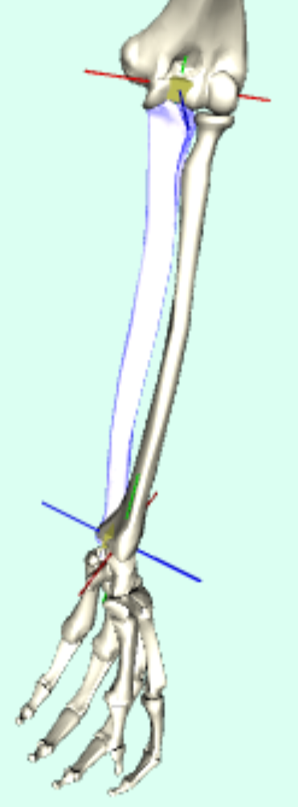
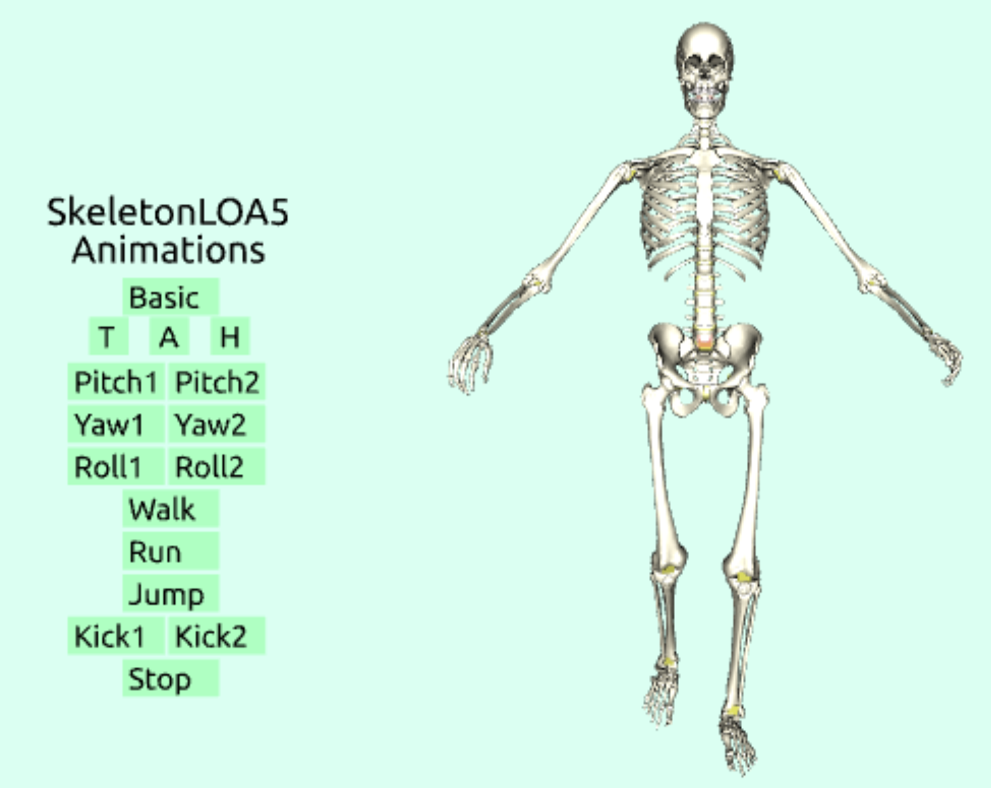
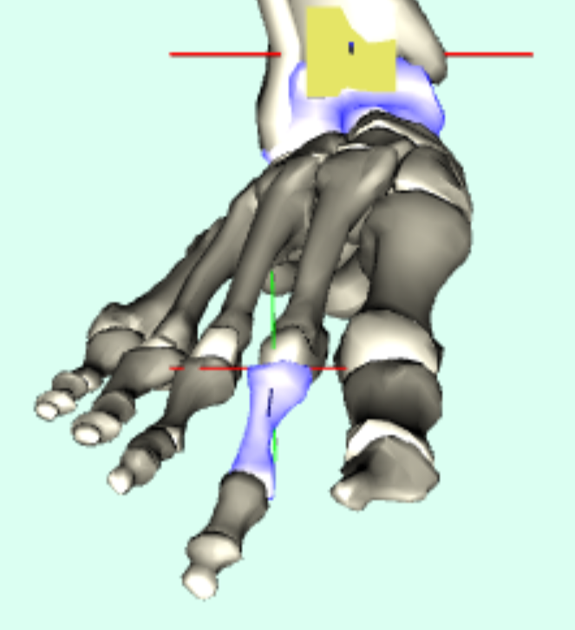
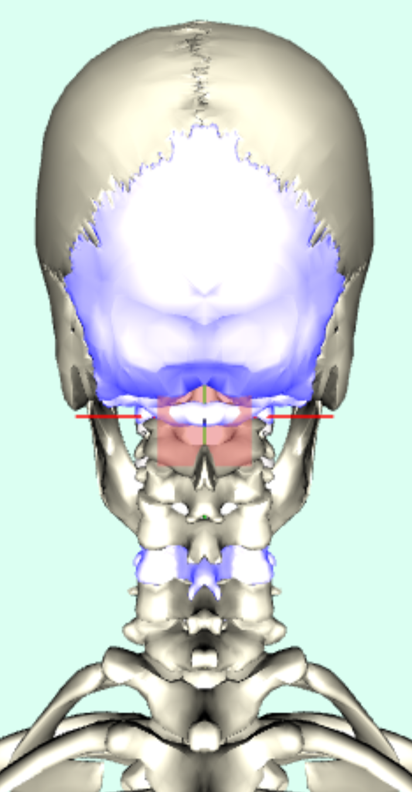
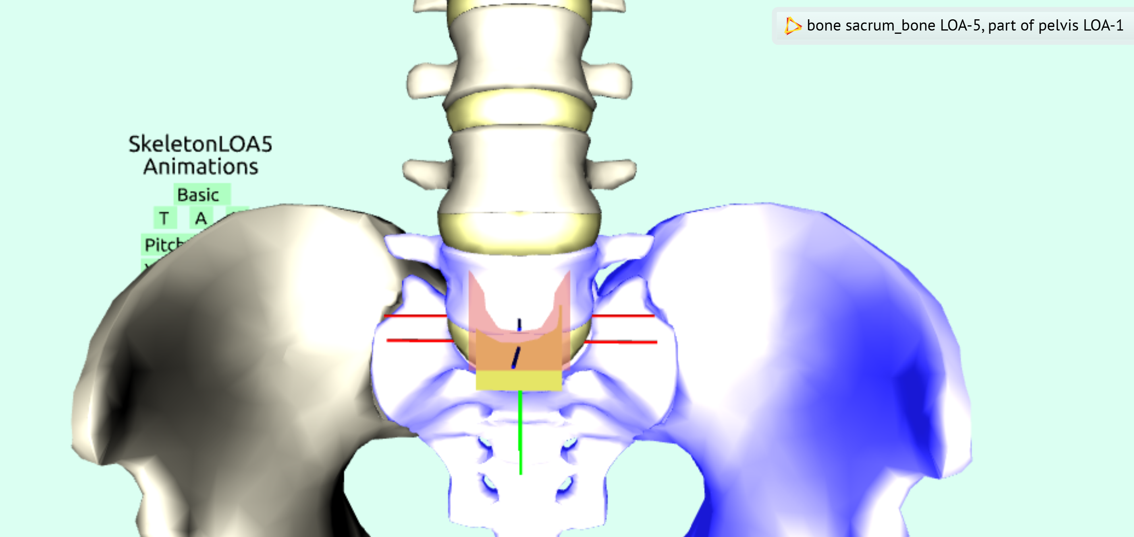
Test scene to visualize Joint centers
X3D Example Archives: Humanoid Animation, Bones,
All Bones LOA 5 Skeletons Inline Animation (full screen)

Slide 27
List of various animation examples
Switchable Interpolators
Green-box pitch/roll/yaw examples
TODO: HAnimPose examples (BoxMan, at least)
TODO: HAnimMotion example derived from BVH data

Slide 28
Conclusions
Yes, we can do it! It has been a long trail, but now results are available for copying the design patterns and good practices.
Demonstration examples illustrate our path for correct animations, X3D HAnim implementations and specifications all work well.
This presentation is outline of paper for Web3D 2026 Conference
We hope to encourage even-better work by others in the future.

Slide 29
Recommendations for these example bone models, building a comprehensive human LOA-5 skeleton
X3D 4.1
HAnim v2.1
Program fine-tuning in progress: ComputeBoneOffsetsForJointCenters.java
Determine in-progress joint center axis of rotation for every bone
  LOA-0 and LOA-1 support complete, continue through each LOA…
  Beside visual inspection, is an accurate computational approach possible?
Add/load Skin mesh connected with comprehensive set of Joint indices
  (note that bone shapes are similar to Jin shapes, but not skin mesh per se)
  Figuring out index correspondences between skeleton and skin mesh is difficult
Add/load Coveroid clothing, similarly and compatibly connected
  Design expectation: this effort is almost identical to efforts with Skin mesh
Show how to add animation-suite interface with any Humanoid model
  Build libraries that include interpolators, HAnimMotion and HAnimPose
Continue building complementary metadata sets, embed descriptions

Slide 30
Recommendations for HAnim Working Group
X3D 4.1
HAnim v2.1
More and more validated example models using X3D for HAnim
  Publicly published as XML, JSON, VRML, Python, Java, C++, etc.
Continuing improvement of our open-source modeling tool suite
  X3D-Edit, Sunrize, X_ITE, Castle, X3DOM, multiple other toods
  Facilitate export, conversion and construction from other model sources
  Quality Assurance (QA) tools for model conversion, correctness
Continued formalization updates to HAnim, X3D specifications
Continued implementation, evaluation, refinement, deployment
  including X3D AI working group training of LLM engines

Slide 31
Recommendations for Web3D Consortium
Compare correspondences with other common approaches shared as part of Metaverse Standards Forum (MSF) avatar efforts
Consider integration with medical standards as 3D health records, for example can we handle individual body proportions, changes?

Slide 32


Acknowledgements
HAnim Working Group participants for regular review discussion: Carol McDonald, Dick Puk, William Glascoe, Myeong Won Lee, Cheryl Sonju, Katy Schildmeyer
Browser builders: Holger Seelig for Sunrize and X_ITE, Michalis Kamburelis for Castle Model Viewer, Andreas Plesch for X3DOM
Damon Hernandez for preserving original models in VRML
John Carlson for program recentering bone model meshes
Cooperative efforts with IEEE Body Processing Working Group
All feedback always welcome. Have fun with HAnim and X3D!

Slide 33
Contact
Don Brutzman don.brutzman@gmail.com Relative Motion Consulting | Joe D. Williams joedwil@earthlink.net
Web3D Consortium Humanoid Animation (HAnim) Working Group

Slide 34
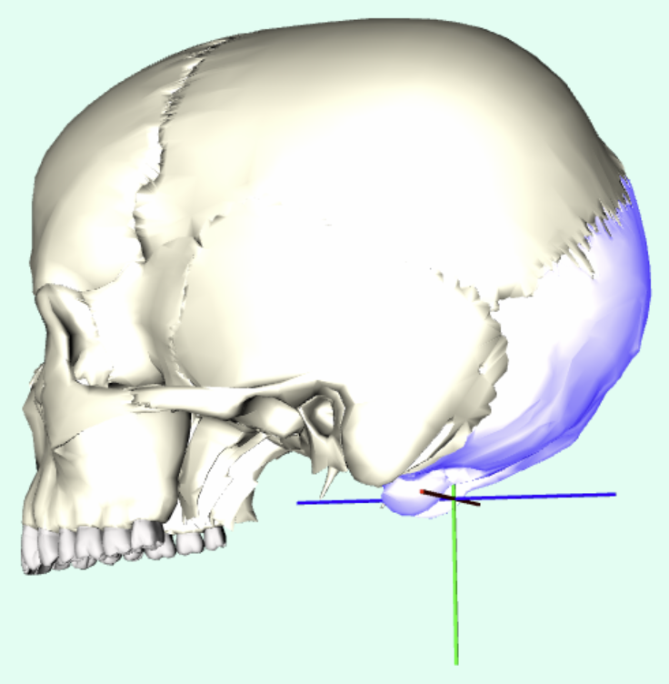
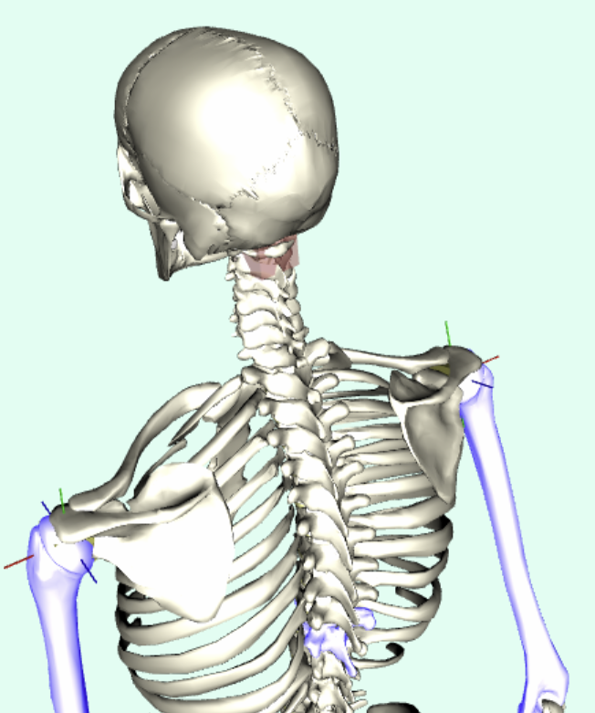
backups

